Slide 1
Counters
Reference
Chapter 7
Registers and Register Transfers
Moris Mano 4th Edition

Slide 2
Counter
A register that goes through a prescribed sequence of distinct states upon the application of a sequence of input pulses
Input pulses may be
Clock pulses
Originate from some other source
May occur at regular or irregular interval of time

Slide 3
Binary Counter
Counter that follows the binary number sequence is called binary counter
An n-bit binary counter consists of n flip-flops and can count in binary from 0 through 2^{n}-1

Slide 4
Types of Counters
Asynchronous Counters
In which C input of some of the flip-flops are triggered not by common pulse but rather by the transitions that occur on other flip-flop outputs
e.g. Ripple counters
Synchronous Counters
In which the C inputs of all flip-flops receive common pulse

Slide 5
Asynchronous Counters

Slide 6
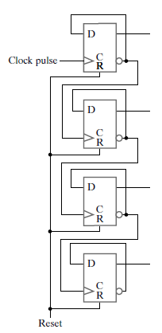
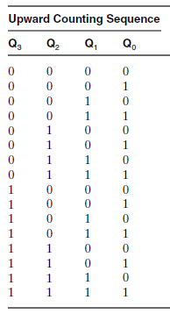
4-bit Ripple Counter
What will be the state of counter on positive edge after 1111?

Slide 7
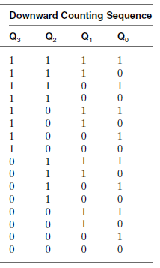
4-bit Ripple Counter
Design a 4-bit ripple counter for downward counting
Can you design an asynchronous Up-Down
Counter with Selection Input?

Slide 8
Synchronous Counters

Slide 9
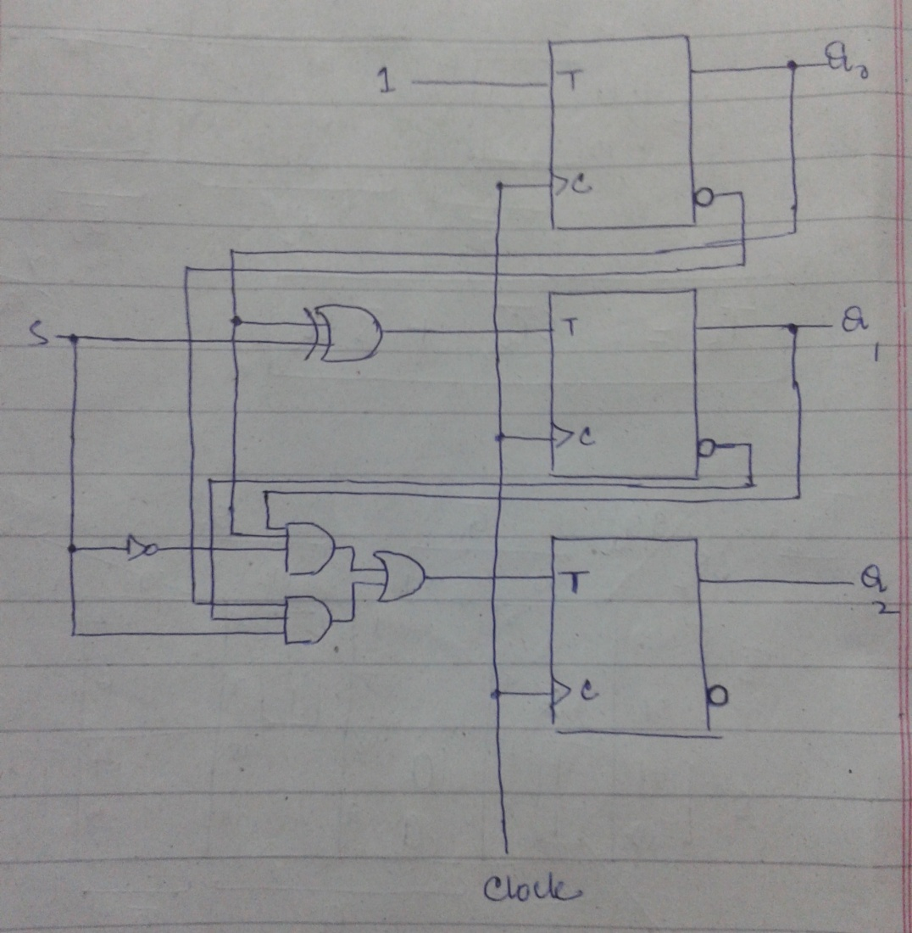
Synchronous 3-bit Up-Down Counter
For S=0
Count Upward
For S=1
Count Downward

Slide 10
Practice Problems
1. Arbitrary Count Sequence: Design a synchronous counter which follows sequence given below:
0, 2, 4, 6, 8, 0, 2,…
2. BCD Counter: Design a BCD synchronous counter which follows the sequence given below:
0,1,2,3,4,5,6,7,8,9,0,1,2,…

Slide 11
Practice Problems
3. Modulo-7 Counter: Which follows the sequence 0,1,2,3,4,5,6,0,1,2,…
4. Digital Watch
For your convenience consider we have 64 seconds in one minute, 64 minutes in one hour and total 32 hours in a day.

Slide 12
Practice Problems
5. Automatic Parking Control
Take CarIn and CarOut signals from sensors at Entry and Exit Gates respectively. Parking area has total capacity of 32 cars, when total count of cars in the plaza reaches 32 lock the Entry Door otherwise the door will remain unlocked.
6. Counter with Parallel Load
Register composed of T Flip-Flops which loads the data if Load = 1 otherwise behaves like a binary counter.

Slide 13
Practice Problems
7. Counter composed of T Flip-Flops which takes X and Y selection inputs and performs following operations:
X | Y | Operation
0 | 0 | Count
0 | 1 | Shift Right
1 | 0 | Shift Left
1 | 1 | Parallel Load

